Slide 1
Computational analysis of oncological drug-binding interactions
Subject: Molecular biology & Cellular physiology
Ethics, innovative research, businesses & IPR AIM112 & AIM115
Janak Dhillon- CB.AI.U4AIM24016 | Sreyas Kumar - CB.AI.U4AIM24045
Srisha Satish Kanna - CB.AI.U4AIM24046 | Abhinav Sarvesh D- CB.AI.U4AIM24052
Presented By:

Slide 2
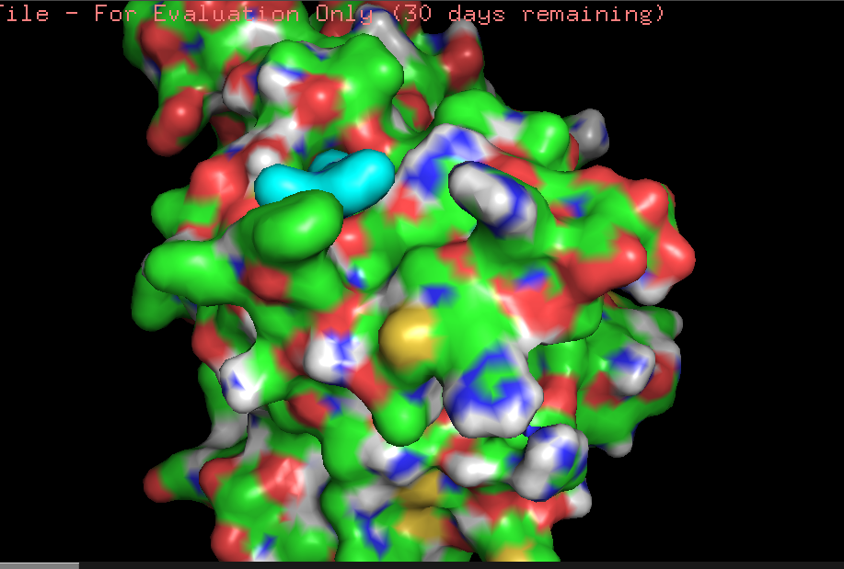
Introduction
Cancer drugs bind to active sites of proteins, particularly those proteins mutated to cause the cancer.
Drug-Binding Interactions: The type of interaction is hydrogen bonding, hydrophobic contacts, or electrostatic interactions determining their pharmacological profile
Computational Techniques in Drug Discovery:
Molecular Docking
Molecular Dynamics Simulations
Machine Learning Tools
Advantages of Computational Methods:
Speeds up drug development through insights into drug interactions.
Reduces costs and enhances the discovery of highly specific drug candidates.
Fig 1: A docked ligand-protein interaction

Slide 3
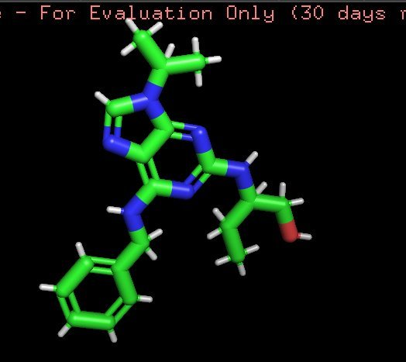
Introduction
Applications:
Precision and personalised drug therapies
Objective:
Understand which drug binds best to a protein from multiple ligands using molecular docking
Statistics application in classifying the best ligand and it’s best binding site
Integration of Machine learning to use the docked model for drug discovery
Understand the ethics, innovative research, businesses, IPR behind this project and patenting as a key component of projects
Fig 2: Ligand molecule

Slide 4
Innovative Research-Literature Review
Title | Author and year | Problem statement | Research gaps
The use of machine learning to discover regulatory networks controlling biological systems | Rossin Erbe, et al., 2022 | Addressing the challenge of modelling complex biological systems, using machine learning-based graphical network models | Current models often focus on gene regulatory networks (GRNs) primarily based on gene interactions, neglecting the influence of ligands on protein behavior.
From Gene Expression To Drug Response: A Collaborative Filtering Approach | Cheng Qian, et al., 2018 | Predicting cancer cell response to drugs using a collaborative filtering approach by modelling gene-drug relationships | Lack of integration between molecular docking and gene expression-based drug response models, limiting mechanistic insights
Application of pharmacogenetics in oncology | Miteva-Marcheva, et al., 2020 | Examining the role of pharmacogenetics in oncology and the challenges of integrating pharmacogenomics into clinical practice | Interaction of multiple genes and their collective influence on drug metabolism requires further investigation
Metabolic drug survey highlights cancer cell dependencies and vulnerabilities | Tea Pemovska, et al., 2021 | Investigating metabolic dependencies in cancer cells, using a metabolic drug library to identify vulnerabilities that can be targeted for therapeutic interventions | Lack of specificity of the drug due to structural similarity and broad binding affinities
Integration of Computational Docking into Anti-Cancer Drug Response Prediction Models | Narykov O et al.,2023 | Predicting cancer drug response using molecular docking scores alongside gene expression and drug molecular descriptors | Fails to assess the interactions between multiple drugs targeting the same protein

Slide 5
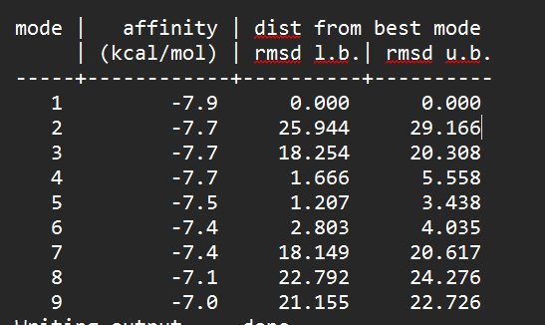
Innovative Research-Computational aspects and Dataset
Computational Aspects to be used :
Docking tools such as AutoDock Vina and PyMol for modifying, visualising and depicting the results after binding.
Machine learning for statistical analysis
Machine learning for drug discovery
Dataset:
For the molecular docking, the protein was taken from PDB(Protein Database Bank) and the ligand was taken from PubChem
Further work will be done one multiple ligand basis, the ligands will be sourced from the same website
For Drug Discovery model, proteins and molecules were sourced from ChEMBL, PubChem, DrugBank
Fig 3: Table showing the results from the log file

Slide 6
Innovative Research-Methodology
One protein, one ligand simulation:
Protein: human mutant p53 protein
Drug: Roscovitine- a cyclin-dependent kinase (CDK) inhibitor
Load protein in AutoDock and edit
The ligand was edited using PyMol software and converted to a pdb file
The pdb file of the ligand was opened in autodock along with the modified protein and a grid was set
Vina was used to dock the binding between the protein and the ligand
Totally 9 binding sites out of which 2 were on completely different sides,
Best binding site decided using the log file created
Machine learning: Drug Design
Bioactivity dataset download
Exploratory data analysis and feature engineering
Molecular descriptor calculation and dataset prep
ML model will predict certain drug designs, and we’re cross verifying that using auto dock vina

Slide 7
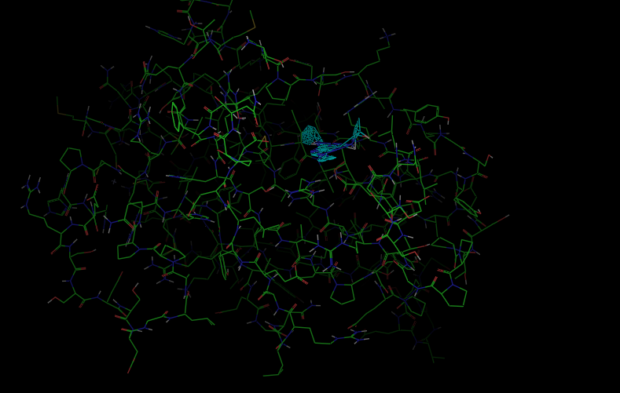
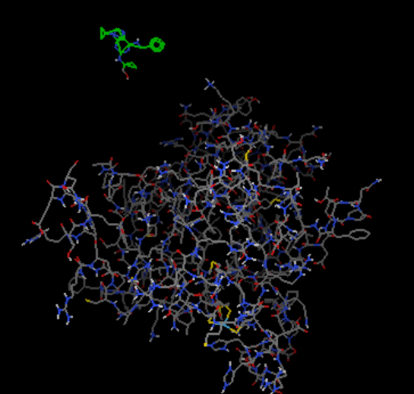
Fig 5: Protein and ligand
Fig 4: Protein-ligand binding

Slide 8
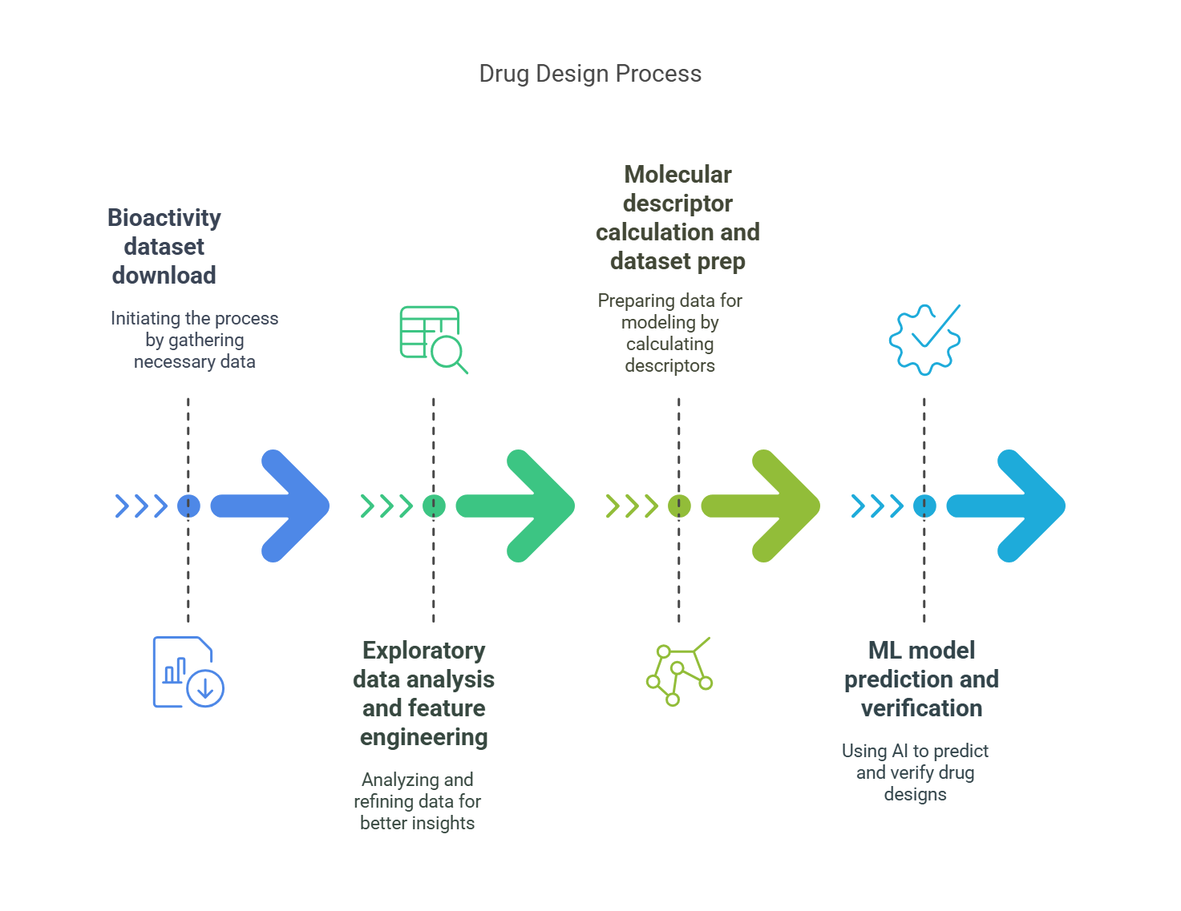
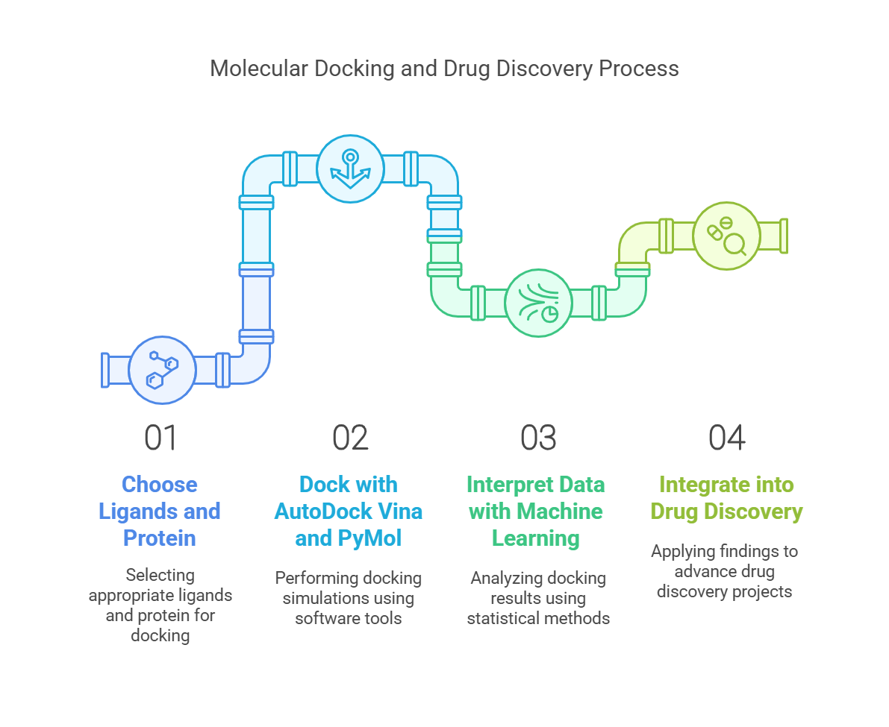
Overall Methodology Overview
Fig 6:Workflow overview
Fig 7: Machine learning overview

Slide 9
Innovative Research-Clinical trial reports and ethics related to this project
A clinical trial is a systematic study to generate data for discovering or verifying the clinical and pharmacological profile or adverse effects of a new drug on humans.
4 phases of clinical trial:
Phase 1: clinical pharmacology trials or “first in man” study
Phase 2: exploratory trials
Phase 3: confirmatory trials
Phase 4: trials: post-marketing phase
Bioethics: The universal principles of bioethics are autonomy, beneficence, non-malfeasance and justice.
Good Clinical Practices(GCP)
Ethical and scientific standard for conducting biomedical and behavioral research
This standard ensures that the rights, safety, well-being, and confidentiality of trial participants are protected
Data collected in clinical trials, as well as the reported results of clinical trials, are credible and accurate

Slide 10
IPR rules: Existing models/ideas patented
IPR protects the exclusive rights of individuals or entities over their inventions impacting personalized medicine
Naturally occurring genes are not eligible for patent protection, but synthetic DNA remains eligible.
The ongoing Patent Office evaluation focuses on personalized medicine, including the immunity of confirmatory secondary genetic tests.
An important issue in personalized medicine is considering the innovation in medicine, investment, and interest.
Existing Patents:
Pharmacogenetic drug interaction management system
Artificial intelligence assisted precision medicine enhancements to standardized laboratory diagnostic testing
Multi-mode deep learning-based anticancer drug combination effect prediction method
Interpretation of genetic and genomic variants via an integrated computational and experimental deep mutational learning framework

Slide 11
References
Erbe R, Gore J, Gemmill K, et al. The use of machine learning to discover regulatory networks controlling biological systems. Mol Cell. 2022;82(2):260–273. doi:10.1016/j.molcel.2021.12.011.
Qian, Cheng & Sidiropoulos, N.D. & Amiridi, Magda & Emad, Amin. (2018). From Gene Expression to Drug Response: A Collaborative Filtering Approach. 10.48550/arXiv.1810.12758.
Miteva-Marcheva NN, Ivanov HY, Dimitrov DK, Stoyanova VK. Application of pharmacogenetics in oncology. Biomark Res. 2020 Aug 17;8:32. doi: 10.1186/s40364-020-00213-4. PMID: 32821392; PMCID: PMC7429778.
Pemovska, T., Bigenzahn, J.W., Srndic, I. et al. Metabolic drug survey highlights cancer cell dependencies and vulnerabilities. Nat Commun 12, 7190 (2021). https://doi.org/10.1038/s41467-021-27329-x
Narykov O, Zhu Y, Brettin T, Evrard YA, Partin A, Shukla M, Xia F, Clyde A, Vasanthakumari P, Doroshow JH, Stevens RL. Integration of Computational Docking into Anti-Cancer Drug Response Prediction Models. Cancers (Basel). 2023 Dec 21;16(1):50. doi: 10.3390/cancers16010050. PMID: 38201477; PMCID: PMC10777918.
Saxena P, Saxena R. Clinical trials: changing regulations in India. Indian J Community Med. 2014 Oct;39(4):197-202. doi: 10.4103/0970-0218.143018. PMID: 25364141; PMCID: PMC4215498.
Kar, Nihar. (2023). ADVANCES IN PERSONALIZED MEDICINE: HARNESSING GENOMICS AND PRECISION THERAPEUTICS. World Journal of Pharmaceutical Research. 12. 618-632. 10.20959/wjpr202317-29780.
US20190172588A1 - Pharmacogenetic drug interaction management system - Google Patents
US20210118559A1 - Artificial intelligence assisted precision medicine enhancements to standardized laboratory diagnostic testing - Google Patents
CN118866097A - Multi-mode deep learning-based anticancer drug combination effect prediction method - Google Patents
AU2024219712A1 - Interpretation of genetic and genomic variants via an integrated computational and experimental deep mutational learning framework - Google Patents

